Slide 1
Deployment and Operations for Software Engineers 2nd Ed
Chapter 5 - Container Orchestration

Slide 2
Outline
Pods
Orchestration and service mesh
Container security

Slide 3
Reducing communication times
Sending a message from one container to another can be time consuming since it involves placing the message on the network.
If the two containers are on the same host, the message can be sent without using the network.
A pod is a construct from Kubernetes that ensures that two containers are deployed onto the same host.
Pods are divided into namespaces for isolation purposes.

Slide 4
Kubernetes architecture
Container 1
Container 4
Container 6
Container 8
Container 3
Container 2
Container 5
Container 7
Container 9
Pod 1
Pod 2
Pod 3 Pod 4
Pod 5
Namespace
Namespace
Namespace
Kubernetes
Container run time
Node

Slide 5
Single container in a pod
The pod has an IP addresses and a collection of ports.
A message is sent to the IP and a port.
The message is passed to the container in the pod.

Slide 6
Multiple containers in a pod
The pod has an IP address and a collection of ports.
Each container listens on one port—distinct from the port of the other containers in the pod.
A message from outside the pod is delivered in the normal fashion to a container in the pod.
A message from one container inside the pod to another container inside the pod can be sent to localhost to avoid overhead. Then it is delivered to the container listening on the destination port.

Slide 7
Container lifetime
Containers in the same pod are allocated and deallocated together. That is, they have the same lifetime.
Two containers should be placed in the same pod if they are tightly coupled—their actions are interdependent.

Slide 8
Discussion questions
Give examples of two containers that should be in the same pod.
Suppose one container in a pod fails. What happens to the other containers in that pod?

Slide 9
Outline
Pods
Orchestration and service mesh
Container security

Slide 10
Orchestration system
An orchestration system manages a container's lifecycle, including provisioning, deployment, scaling, and load balancing.
Common orchestration systems are Kubernetes, variants of Kubernetes by Google, Amazon, Microsoft, and Red Hat, and Docker Swarm.
Istio is a common service mesh

Slide 11
Kubernetes specification
In YAML
Pod name
Containers included in the pod
Number of instances of the pod to create
Autoscaling rules
…

Slide 12
Orchestrators and Service Meshes
Orchestrators frequently work in conjunction with a service mesh.
Division of responsibilities shown is notional. Some functions may exist in either the orchestrator or the service mesh.
scaling, load balancing,
distributed coordination
Provisioning, Deployment
Orchestrator
Discovery, communication patterns, monitoring, Security enforcement
Service Mesh

Slide 13
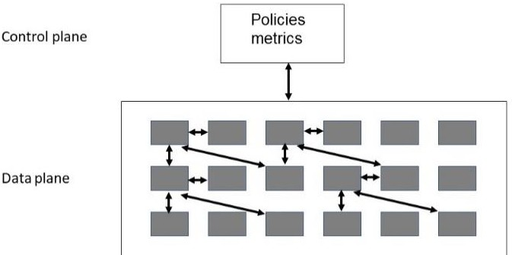
Basic architecture of a service mesh

Slide 14
Control plane and data plane
The control plane is where management functions are performed
The data plane is where communication is performed.
Discovery service is packaged in pod with service mesh.
Multiple instances of discovery service- one for each pod
The discovery service will include IP address of containers in a particular context.

Slide 15
Context
Context rules are specified in the policy section of the control plane
Context includes
Instances of containers within same pod or same host.
Containers participating in canary or A/B testing
Shadowing for availability
Access control

Slide 16
Discussion questions
How are orchestration rules specified in Kubernetes?
How is a discovery container populated?

Slide 17
Outline
Pods
Orchestration and service mesh
Container security

Slide 18
Container security publication
NIST (National Institute for Science and Technology) has published a guide to securing containers.
https://nvlpubs.nist.gov/nistpubs/SpecialPublications/NIST.SP.800-190.pdf

Slide 19
END OF CHAPTER 5

